Slide 1
Security Enhancement: Physical Infrastructure
Upgrading of two facilities under the Regional Security Upgrades Program (ANSTO & GTRI)
10 Mac 2009 Meeting with UMMC & Steril Gamma
22- 27 Mac 2009 – Visit by DOE to review the above facilities for security upgrades

Slide 2
Security Enhancement: Technical Capabilities
Enhancing
Emergency
Response
Capabilities

Slide 3
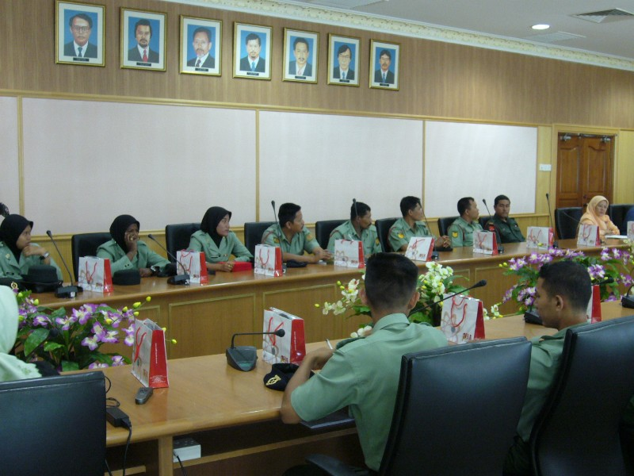
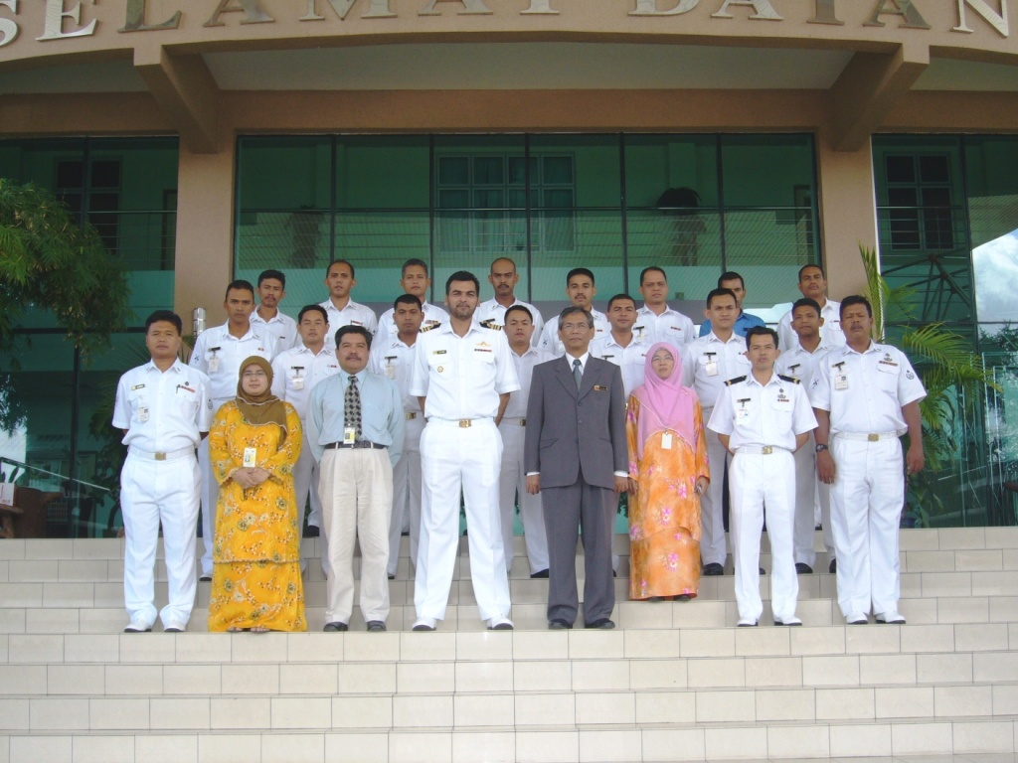
Security Enhancement: Technical Capabilities
Cooperation with National Enforcement Agencies

Slide 4
Awareness & Training
Awareness & Training to Public & Licensee
10 Dec 2007: National Convention on the Safety, Security & Safeguarding of Nuclear & Radioactive Materials
30 June 2008: National Awareness Seminar on the Safety & Security of Radioactive Sources
15 July 2008: National Workshop for Industrial Radiographer
4 – 6 Aug 2008: NTC on PP & Security Management of Radioactive Sources
13 Jan & 18 Feb 2009 : Briefing on License Conditions with Security Requirements

Slide 5
Awareness & Training
Awareness and Guidance Documents
LEM/AM – Orphan Sources – 30 June 2008
LEM/TEK – Safety & Security of Radioactive Sources – 30 June 2008
Circulars to Licensee
Adoption of Supplementary Radiation Symbol for Category I Radioactive Sources
Adoption of CoC and its supporting guidance documents

Slide 6
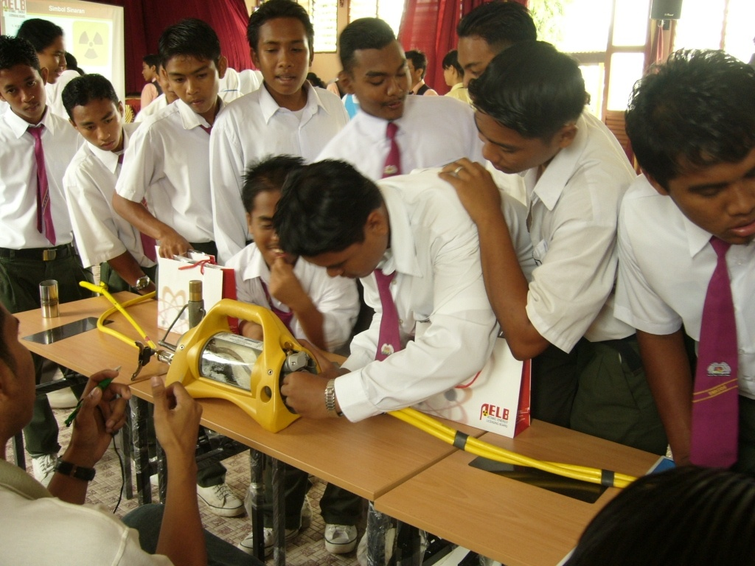
Awareness & Training
Community
Awareness
Program

Slide 7
Awareness & Training
Awareness & Training to Enforcement Agencies
NTC on Monitoring, Detection, Identification & Response to the Illicit Trafficking of Nuclear & Radioactive Materials at International Borders, June 2005
National Convention on the Safety, Security & Safeguarding of Nuclear & Radioactive Materials, 10 Dec 2007
Training Kit for Training on “Monitoring, Detection, Identification & Response to the Illicit Trafficking of Nuclear & Radioactive Materials at International Borders” developed & adopted in November 2007

Slide 8
Awareness & Training
Training of AELB Officers
Sept 2007 : AELB Guards & other Non Technical Staffs (2 ½ days)
Sept 2007 : Technical Talk on CoC, Categorization & New Security Measure (1 day)
7 – 11 April 2008 – Workshop on Enhancement of Security Elements under Act 304 (5 days)
26-28 May 2008 – Training Course on Safety & Security of Radioactive Sources on (3 days)

Slide 9
More new initiatives
Draft guidelines and pamphlets to public and licensee
Security in Transporting Radioactive Sources
Guidance Document to Prepare Security Plan
Seminar on Radioactive Material Security to Licensee
To be carried out every two months until full implementation (2011)
Amendment of Act 304 – specific requirements on security
Draft regulations on Radioactive Material Security

Slide 10
Conclusion
Malaysia, through AELB is taking steps towards the enhancement of safety and security measures of radioactive sources
Safety and Security of Radioactive sources will be enhanced
All authorized radioactive sources will continue to be in control of the users and regulator

Slide 11
Thank You.
Q & A
Ensuring Safety, Security & Safeguarding Peaceful Nuclear Activities

